Slide 1
ENGG1003
Introduction to procedural programming

Slide 2
Staff
Course Co-Ordinator: Prof. Rick Middleton
Email: Richard.middleton@newcastle.edu.au
Room: ICT311
Consultation: By appointment through Jasmine McGee: Jasmine.Mcgee@newcastle.edu.au
Primary contact for final exam adverse circumstances applications

Slide 3
Staff
Me: Mr. Brenton Schulz
Consultation: EF106, Thursday 10am-5pm
Email: Brenton.Schulz@newcastle.edu.au
Assume any non-exam problem comes to me
Lab demonstrators
Too many to mention, you'll meet them in labs
Mix of postgrad and undergrad students
Ask them about their work, future studies, etc!

Slide 4
About Me
Massive nerd
Who else would teach programming?
Enjoy all types of music
Thrash metal, death metal, power metal, pirate metal, black metal
Yeah, all types
Enjoy games where you just shoot everything
DOOM
XCOM
Serious Sam
Quake III
Ok, maybe you weren't born yet

Slide 5

Blackboard
Accessed via: http://uonline.newcastle.edu.au
Does anyone use QR codes? Didn't think so, have one anyway.
All courses upload notes, lecture recordings, announcements, grades, etc. to Blackboard
Your responsibility to check regularly. Typically daily.

Slide 6
Course Classes
Two lectures / week
This one (9-11am, RW149 aka "Nursing lecture theatre")
Overflow when required, EAG01, up the stairs in Engineering building "A"
Friday 9-10am, HD01 aka "Griffith Duncan Theatre "
A 3hr computer lab. Starts this week!
You sit at a PC among 20-40 other students and get given tasks to do
Tasks distributed on Blackboard, typically a PDF, maybe template code
One or two demonstrators are paid to be there and answer your questions

Slide 7
Textbooks
Same as previous years
Jeri R Hanly & Elliot B Koffman, Problem Solving and Program Design in C (7th Ed.), Pearson 2013 (ISBN 978-0-13-293649-1)
Holly Moore, MATLAB® for Engineers (Edn 3), Prentice-Hall 2012, (ISBN 978-0-13-210325-1)
Not strictly required
There are thousands of websites that cover C
The course notes are written with the aim of being self-contained
Buy a 2nd hand copy or access library resources (this includes eBooks via http://library.newcastle.edu.au)

Slide 8
Thinking of dropping Out?
Come talk to me! What can be done to help?
HELP census, 22nd of March
Allows you to withdraw without financial or academic penalty
Withdrawing before the final exam period does not incur academic penalty
You still pay for the course though

Slide 9

Where to find help
Google
Copy/paste error messages
Search for C tutorials (there are lots)
Your lab demonstrator
Only during enrolled lab times
They will help you Google
Textbooks
Me, EF106, Thursday10am-4pm
Or via email: Brenton.Schulz@newcastle.edu.au

Slide 10
Assessments
Passing grade is 50%
Must also score 40% or higher in the final exam
Assessed Laboratory 1, Week 4, 5%
Mid-semester quiz, Week 6, 10%
Programming assignment 1, Week 7, 12.5%
Assessed Laboratory 2, Week 9, 5%
Assessed Laboratory 3, Week 11, 5%
Programming assignment 2, Week 13, 12.5%
Final Exam, TBA 50%

Slide 11
Assessments
Programming is quite unforgiving
If you develop code on a private machine it may not work on the university computers
Assessment demonstration on privately owned laptops is totally fine
Uni IT doesn't support Linux but I wholeheartedly do
Feel free to demonstrate assignments using vim/make/gcc
All assessments (except the final exam) are held during your lab session
Assessment in a different lab session requires approval from me
The demonstrators will have class lists

Slide 12
What is "Procedural Programming"?
Telling a computer what to do via a list of steps
Written in a language the computer can understand
Ideally, the human writing understands it too
This course covers the languages "C" and MATLAB.
Created in the 1970s isn't C as old as my parents? How is this still relevant?
Well, lets check a 2018 IEEE survey
Why not Python?
Politics. Python's dominance is quite new and no 2nd/3rd/4th year engineering courses use it (yet).

Slide 13
Why do I need programming?
ELEC/MECHA/Computer systems engineering
Embedded systems - C
Programming small computers in home appliances, UAVs, wireless sensors, IoT, etc
You will all do this in ENGG1500 on the "Arduino" microcontroller platform
Control systems - MATLAB
Designing mathematical models which make a thing do a thing
Eg: Car cruise control, temperature control, controlling robot arms, etc
Numerical methods – C and MATLAB
Catch-all term for any kind of heavy lifting arithmetic done on a PC or supercomputer
Applications typically quite specific

Slide 14
Why do I need programming?
MECH/CHEM/Medical/Aerospace
Many of you will program embedded systems in C
MECH students use Arduinos in 2nd year
Almost all medical equipment is an embedded system.
MATLAB is used all over the place for things I don't understand.
Ask your demonstrators in other courses

Slide 15
What Is A Computer?
How is this relevant to this course?
In order to write instructions (programming), you must have a relevant understanding of how computers work
A Computer is an electronic device designed to perform calculations very quickly
This seems rather restrictive, just performing mathematics
But when you consider its other capabilities
Speed
Communication with other electronic devices (peripherals)
Then mathematics gives you
A word processor, sinus rhythms of a persons heart, how the ailerons should move to bank a plane, how a robot should weld a car body, how much heat is needed to maintain a chemical reaction, weather predictions, etc.
Notes:
Rather restrictive, after all what possible use is a machine that can only do mathematics?

Slide 16
Fundamental Components
Fundamental components of every computer
INPUT
PROCESSING
OUTPUT

Slide 17
Input
Computers only understand electrical signals
More specifically those signals represent two states ON or OFF (binary 0 or 1)
What about a keyboard?
It is a device which converts each keystroke into a series of ON/OFF voltages
What about a mouse?
It is a device which converts movements into a series of ON/OFF voltages
For our model we consider INPUT to be
Any series of ON/OFF voltages which the computer needs to perform its calculations
A device that generates INPUT we will call an INPUT DEVICE
Notes:
You might argue that we type on a keyboard which consists of 26 letters, 10 numbers and various other function buttons

Slide 18
PROCESSING
PROCESSING is the main function of a computer
Once the INPUT for a calculation is available, the computer will perform some PROCESSING
PROCESSING is a series of manipulations performed on the INPUT
This involves following a very specific set of instructions
The writing of those instructions is called programming

Slide 19
OUTPUT
Once the PROCESSING is complete
The computer must have a way of presenting the results
This is the OUTPUT
OUTPUT is any series of ON/OFF voltages that represents the results of PROCESSING
To make the OUTPUT more useful we need an output device

Slide 20
Output
OUTPUT DEVICE is any peripheral that takes a series of ON/OFF voltages and manipulates them into something useful
Examples:
Printer
Monitor
Auto cruise control
LCD showing the oxygenation level of a patient’s blood
Rudder adjustment in a fly by wire system

Slide 21
EXAMPLE Fundamental Components
Fundamental components of every computer
INPUT
PROCESSING
OUTPUT
ON
and
Add the two inputs
ON
OFF
OFF
00010101
and
10011001
10101110
21
and
153
174

Slide 22
PROCESSING In Detail
PROCESSING is complex
Requires multiple key sub-components to help
For our purposes we define
PROCESSOR
MEMORY
SOFTWARE
INPUT
PROCESSING
OUTPUT
PROCESSOR
MEMORY
SOFTWARE (INSTRUCTIONS)
DATA (SCRATCHPAD)

Slide 23
Processing in Detail - PROCESSOR
PROCESSOR
Performs mathematical and data manipulation tasks
Has sub-components, but they are not relevant for this course

Slide 24
Processing in detail - Everything is a number
Computers can only process numbers
Things that aren’t numbers need to be represented by them
Text: ASCII and Unicode
Pictures: each pixel allocated a red-green-blue intensity value
Sound: the “waveform” is sampled at regular intervals and stored as a series of numbers
(NB: multiple systems exist for all of the above)

Slide 25
Processing in Detail - MEMORY
MEMORY
Like humans, computers need to store intermediate results
MEMORY acts like a set of written notes for the computer
Further relevant subdivision
SOFTWARE – Instructions for the calculation
DATA – The information required for the calculation (scratchpad)

Slide 26
Processing in Detail - Software
SOFTWARE
This is the main event for this course (C or MATLAB®)
These are the detailed instructions that the PROCESSOR will follow to perform the desired calculations
Instructions directly understood by the PROCESSOR are
Very specific to each PROCESSOR manufacturer (Instruction Set)
Limited in number
Simple, e.g., Add number in memory location 1 to the number in memory location 2 and put the result in memory location 3
Again each instruction is encoded as a series of ON/OFF voltages

Slide 27
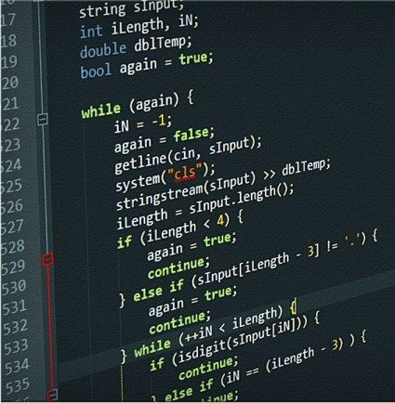
SOFTWARE
SOFTWARE for our purpose will be divided into three groups
MACHINE code
ASSEMBLY language
HIGHER-LEVEL languages

Slide 28
SOFTWARE – MACHINE Code
The PROCESSOR can only understand MACHINE code
Example, one instruction for a x86 based CPU
0110 0110 1000 0011 1100 0000 0000 1010
Difficult for humans to understand
Very PROCESSOR specific
Will not be understood by another PROCESSOR

Slide 29
SOFTWARE – ASSEMBLY LANGUAGE
ASSEMBLY Language
Uses simple mnemonics to describe the purpose of the instruction
Example, one instruction for a x86 based CPU
Machine code: 0110 0110 1000 0011 1100 0000 0000 1010
Assembly language: ADD AX, 10
A bit easier for humans to understand
Still PROCESSOR specific

Slide 30
SOFTWARE – Higher-Level LANGUAGEs
HIGHER-LEVEL Languages (C, MATLAB, Java, Python, C++, FORTRAN,…)
Uses more human readable instructions
Increases the complexity of each instructions so that common calculations can be done with fewer instructions
Example, one instruction for a x86 based CPU
Machine code: 0110 0110 1000 0011 1100 0000 0000 1010
Assembly language: ADD AX, 10
In C: AX = AX + 10;
Much easier for humans to understand
Not PROCESSOR specific
Allows writing of much more complicated instructions

Slide 31
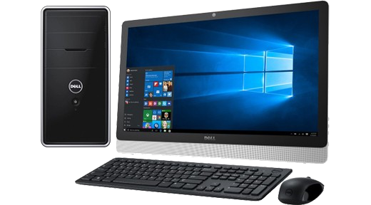
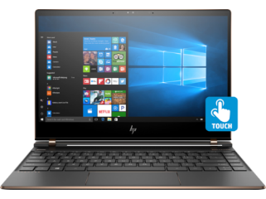
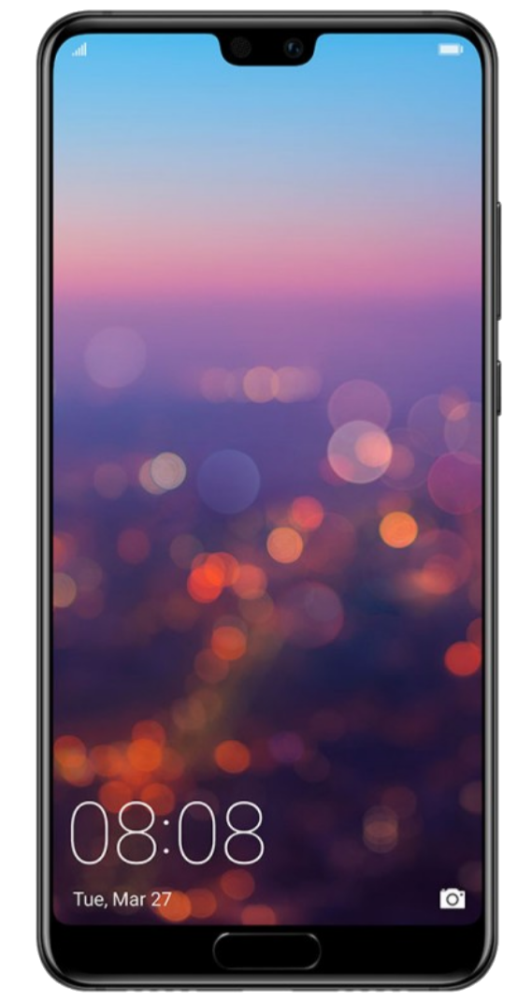
Recognising Computers
Device | Specification
Desktop PC | INPUT DEVICE: Keyboard and Mouse OUTPUT DEVICE: Monitor, Speakers PROCESSING: PROCESSOR: Intel i7 64-bit CPU MEMORY: 8GB RAM
Laptop | INPUT DEVICE: Keyboard and Touch Display OUTPUT DEVICE: Monitor, Speakers PROCESSING: PROCESSOR: Intel i7 64-bit CPU MEMORY: 8GB RAM
Smart Phone | INPUT DEVICE: Touch Sensor, Microphone, Accelerometers, GPS receiver, 4G Receiver OUTPUT DEVICE: Display, Speaker PROCESSING: PROCESSOR: Qualcomm Snapdragon 808 ARMv8-A 64-bit CPU MEMORY: 8GB RAM

Slide 32
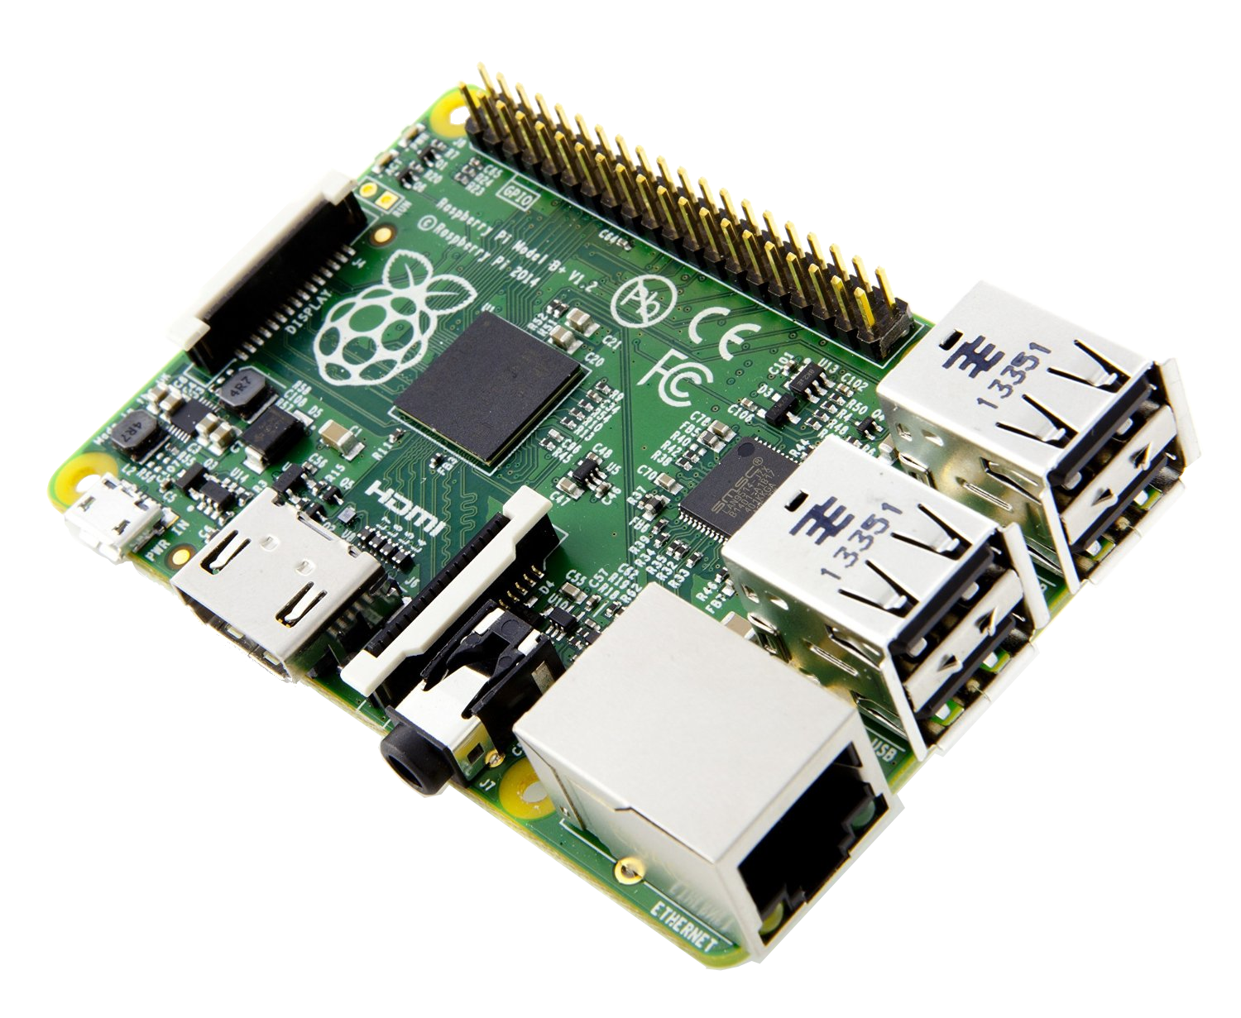
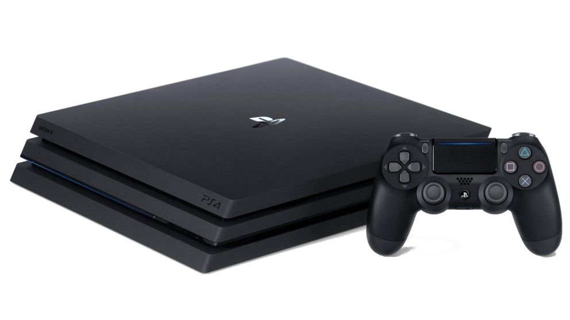
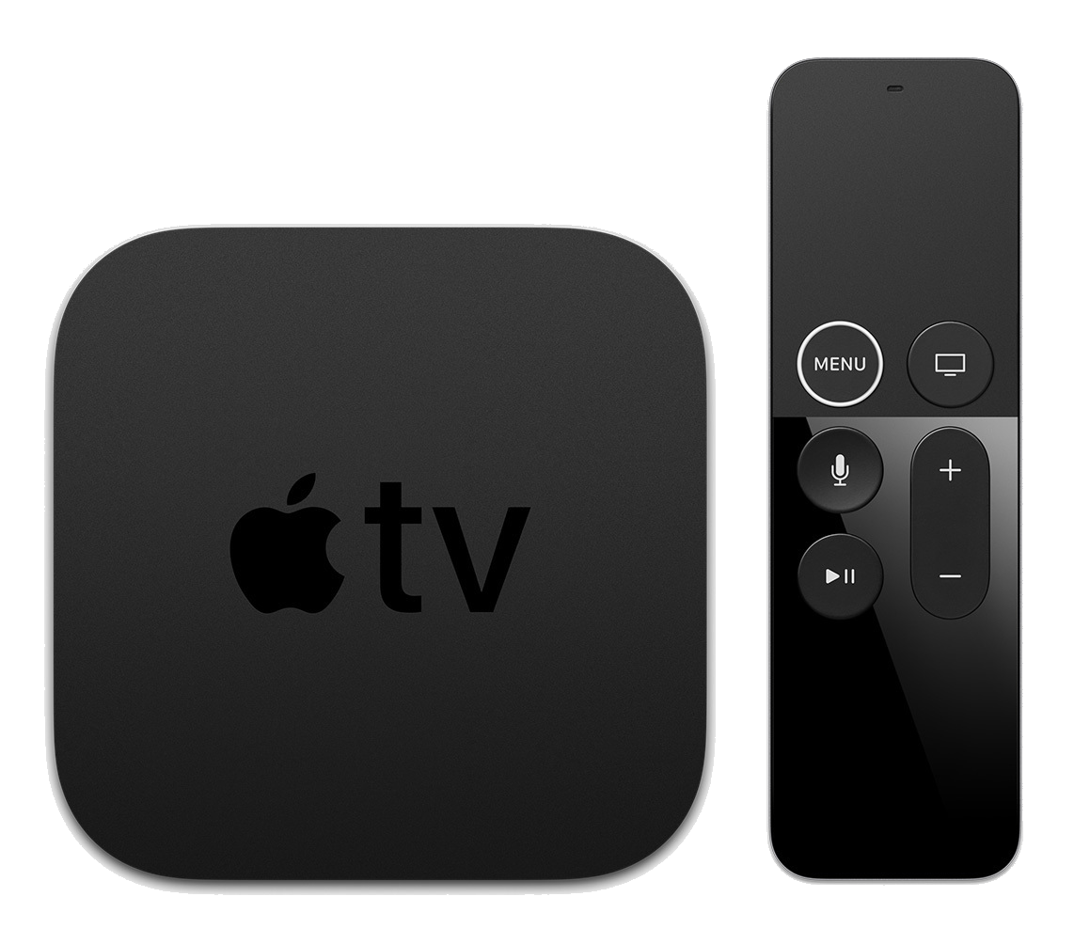
Recognising Computers
Device | Specification
Raspberry Pi 3+ | INPUT DEVICE: Keyboard, Electrical signals (I/O) OUTPUT DEVICE: HDMI Port to Display, USB, Audio PROCESSING: PROCESSOR: Broadcom BCM2837B0 64-bit quad-core ARM Cortex-A53 CPU MEMORY: 1GB RAM
Sony PlayStation 4 | INPUT DEVICE: Gaming Controller OUTPUT DEVICE: HDMI Port to Display PROCESSING: PROCESSOR: AMD x86-64 “Jaguar” CPU MEMORY: 8GB RAM
Apple TV | INPUT DEVICE: Remote control OUTPUT DEVICE: HDMI Port to Display PROCESSING: PROCESSOR: Apple A10X Fusion ARM 64-bit CPU MEMORY: 2GB RAM

Slide 33
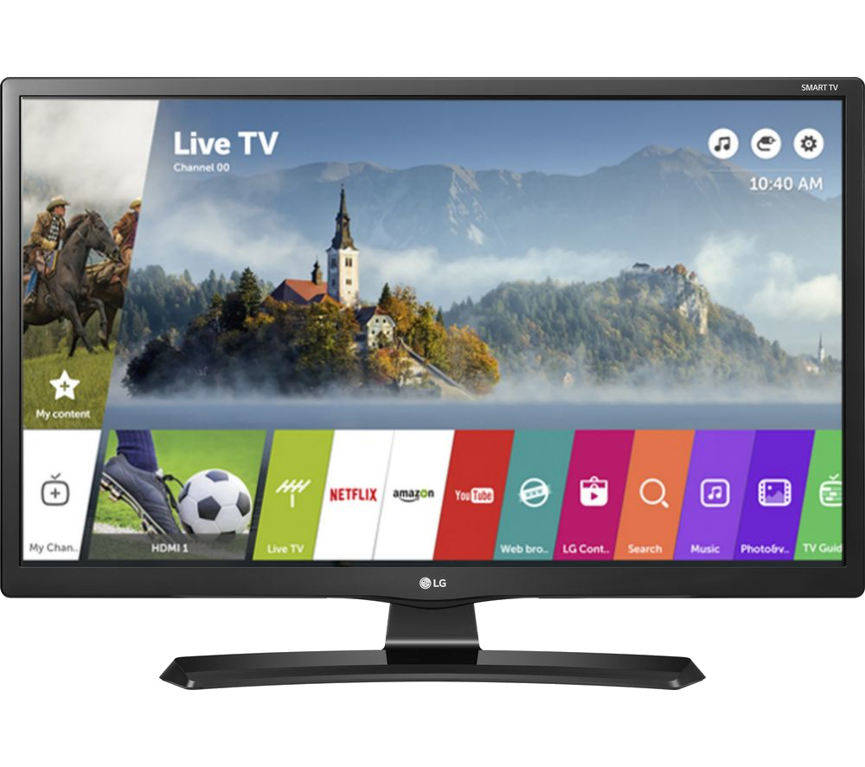
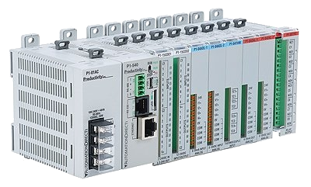
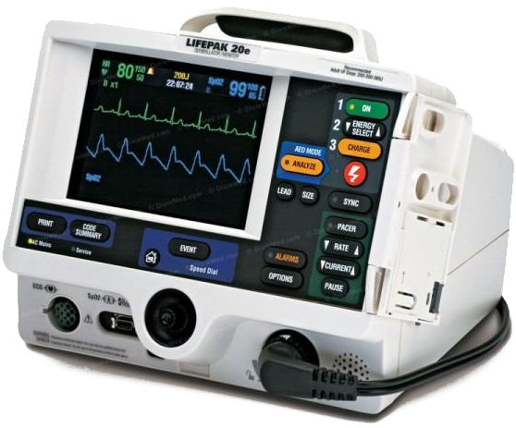
Recognising Computers
Device | Specification
Smart TV | INPUT DEVICE: Remote OUTPUT DEVICE: Display PROCESSING: PROESSOR: Dual-core ARM Cortex-A9 1Ghz MEMORY: 1GB RAM
PLC (Programmable Logic Controller) | INPUT DEVICE: Electrical signals OUTPUT: Electrical signals PROCESSING: PROCESSOR: Intel 8051 CPU MEMORY: SOFTWARE: 2KB RAM DATA: 128B RAM
Defibrillator | INPUT DEVICE: Electrical signals from electrodes OUTPUT: Defibrillation current PROCESSING: PROCESSOR: STM32 STM32F429 ARM-Cortex M4 32-bit CPU MEMORY: 256KB RAM

Slide 34
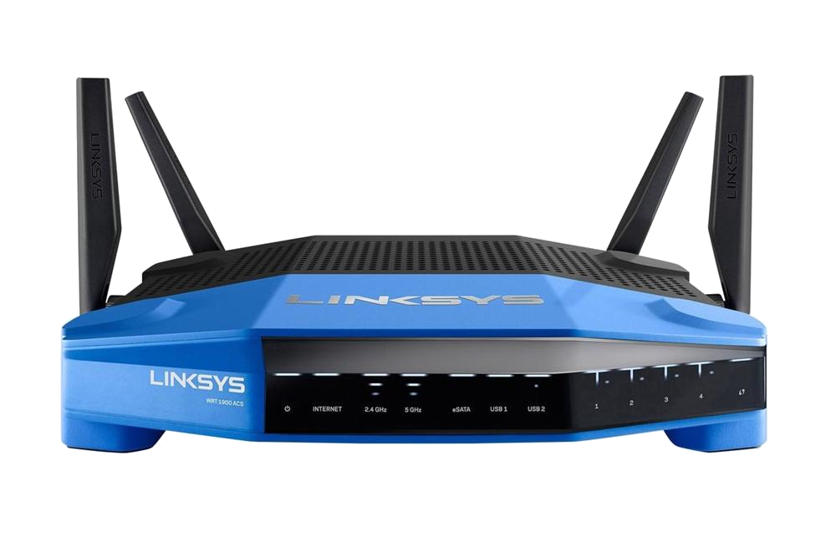
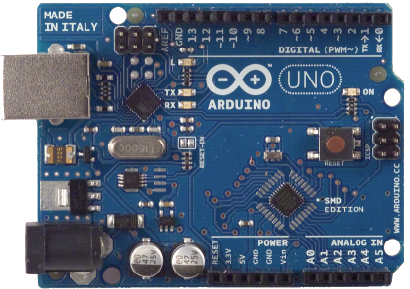
Recognising Computers
Device | Specification
Network Router | INPUT DEVICE: Ethernet, Radio Signals OUTPUT DEVICE: Ethernet, Antennae PROCESSING: PROCESSOR: Broadcom BCM21664T Dual-core ARM Cortex-A9 32-bit CPU MEMORY: 1GB RAM
Arduino UNO | INPUT DEVICE: Electrical signals OUTPUT: Electrical signals PROCESSING PROCESSOR: Microchip ATmega328 8-bit Microcontroller (CPU) MEMORY: SOFTWARE: 32KB RAM DATA: 2KB RAM

Slide 35
RECOGNISING Computers
All these devices are
Computers
Have the fundamental elements INPUT, PROCESSING and OUTPUT
What does this mean for you as a programmer?
Be aware that your target computer may have limitations (INPUT, PROCESSOR, MEMORY and OUTPUT)
Different computers have different programming requirements

Slide 36
INTRODUCTION TO C – FUNDAMENTAL CONCEPTS
C is a compiled language
This means a compiler takes code from a text file and creates a binary
The binary can then be executed by a computer
In this course "computer" will be a lab PC or cloud server
Could be a microcontroller, mobile phone, supercomputer cluster, etc
We will start with http://onlinegdb.com
Website contains an editor, code is executed on their server
Later: an integrated development environment (IDE)

Slide 37
Introduction to C –Fundamental Concepts
Moving data into and out of a C program
Standard Input: text characters read from a keyboard
stdin
Could also come from other places, beyond this course
Standard output: text characters sent to the screen
stdout
Typically printed to a console. Other destinations beyond this course
File I/O: from or to files stored on a hard disk / USB flash drive / etc
Covered in later weeks

Slide 38
Introduction to C –Fundamental Concepts
Other input/output methods beyond this course:
Microcontroller pins (GPIO – in ENGG1500 and ELEC1710)
Embedded systems communication standards, Covered in ELEC2720, ELEC3730, MCHA-something
I2C
SPI
UART
TCP/IP networking
USB devices
Loads of others

Slide 39
Structure of a basic C program
Absolute bare minimum:
int main() {
return 0;
}
main() is a special function. It defines where the program starts executing.
The braces { … } encompass everything inside main().
When execution reaches return 0; the program stops executing (ie: exits).

Slide 40
Structure of a basic C program
That's nice, but it does nothing!
(ok fine, it returns zero to the operating system. Sheesh.)
(You don't need to know what this means)
Lets add some more code to make it do more than "nothing":
#include <stdio.h>
int main() {
printf("Hello World!\n");
return 0;
}

Slide 41
Structure of a basic C program
#include <stdio.h>
This “includes” a header file
stdio.h holds the definition of the printf()function
The "definition" is called a function prototype. More on this in week 5-ish
printf("Hello World!\n");
This line calls printf()
The stuff between the "…" symbols gets sent to the screen (more on this later)
\n means "new line". This isn’t done unless you tell it to!

Slide 42
Structure of a basic C program
A few notes:
Yes, the code looks weird
When was the last time you typed # < > ( ) { } ; ?
You need to get used to it
This is why the first lab tells you to type out code
The return 0; is semi-optional.
In this course code will run fine without it
Compiler may issue a warning
Likewise: "int" before "main()" is semi-optional

Slide 43
Syntax
What on Earth is syntax?
In human languages: the order of words in a sentence
Are you going to the movies on Tuesday?
Are you on Tuesday to the movies going?
In computer languages: the structure of the text given to the compiler
For example, the main() function syntax is:
The word "main" followed by ()
An opening brace: {
[a bunch of stuff that defines what your program does]
A closing brace: }

Slide 44
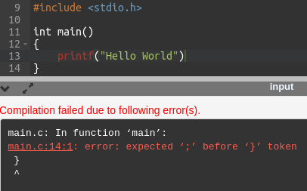
Syntax
The syntax rules in C are very strict
Missing any syntax rule will result in the compiler generating syntax errors
Eg:

Slide 45
Whitespace
Whitespace is any tab, space, or newline character
C typically ignores whitespace
This formatting is totally fine for the compiler:
#include<stdio.h>main(){printf("Ohai\n");}
Humans tend not to like it though

Slide 46
Indenting Styles
Use of whitespace is known as an indenting style
Examples:
Adhering to an indenting style makes code easier to read
I don't want to be too "religious" about it
Just be consistent
int
main()
{
printf("stuff");
}
int main() {
printf("stuff");
}

Slide 47
Case Sensitivity
C is case sensitive.
This means that main() is totally different to Main() or MAIN()
Fundamental reason: m and M are different ASCII characters

Slide 48
Fundamental Concepts – Input
We saw printf() for text output
One function which reads standard input is scanf()
It reads input text and converts it into other datatypes
Eg: the text “13” to the number 13
There are many others, keep it simple for now.
But where does the input go inside the program?
New fundamental concept: variables

Slide 49
Fundamental Concepts - Variables
A variable is something that stores data
"Data" is one or more numbers
Each variable needs a unique name
The compiler decides where in memory it is stored
More on this in later weeks – it gets complicated
For now: Different variables are stored at different memory locations
In C variables have a specific type
For now: lets look at int

Slide 50
Fundamental Concepts - Variables
The int datatype can store any number from –2147483648 to 2147483647
Designed to store integers
Can't store "fractional" components. 2.7 = 2.
The weird numbers above are:
2³¹-1
-2³¹
Before use, all variables must be declared
Eg: int a; creates a variable of type int called "a"

Slide 51
scanf() Example
scanf("%d", &a);
Reads an integer and stores it in the variable a
The "%d" is called a format specifier.
&a means "the address of a"
It tells scanf() where to store the number it reads
ie: In the memory location allocated to the variable a
Lots of details glossed over, more on all this later

Slide 52
Input-Output C Example
Lets put together a variable, scanf(), and printf():
What happens if you don't type an integer? Lets run the example...
#include <stdio.h>
int main() {
int a;
scanf("%d", &a);
printf("You typed the number %d\n", a);
return 0;
}

Slide 53
Fundamental Concept: Assignment
Computer languages use the = character for assignment
This is distinctly different from algebraic equality!
Assignment means:
"Take what's on the right side and store it in the thing on the left"
You can read "a = a + 5" as "a becomes a plus 5"
Eg: Give the variable x the value 2:
x = 2;
Eg: Add a and b together, store the result in c:
c = a + b;

Slide 54
Putting it all together
Lets write a program which:
Reads 2 integers from stdin on 2 lines
"on 2 lines" means the user needs to press enter after each number
Multiplies them together
Prints the result to stdout

Slide 55
Simple Processing Example
#include <stdio.h>
int main() {
int a, b, c;
scanf("%d", &a);
scanf("%d", &b);
c = a*b; // The * character means multiply
printf("%d\n", c);
}

Slide 56
Fundamental Concepts: Comments
In C all text after // is a comment
Text between /* and */ is also a comment
A comment is text which is ignored by the compiler
Use comments to explain your code
Code written more than 2 weeks ago might as well had been written by somebody else
Assume the next person reading your code is a stalker who knows where you live
"Good" commenting is highly context dependent
In this course, assume comments are for a peer who is aiming for 50%.

